Slide 1
Using ai to accelerate your game (PART 2)
Stuart Schaefer, Microsoft
Yury Uralsky, NVIDIA
Daniel Kennett, Microsoft

Slide 2

Windows Machine Learning
Introduction
Applications of ML to make games more real are rapidly becoming more practical
Windows Machine Learning allows developers to utilize trained models for inference on AI capable silicon running with Windows
Create ML models with training frameworks, convert to ONNX, and integrate Windows ML in your game workflow
ML Superscaling vs Bilinear Upscaling

Slide 3
Windows ML Architecture
Application #1
Application #2
WinML API
  Win32 & WinRT Layers
  Converts images to Tensor Resources
  Available on all Windows editions in 2018
Inference Engine
  Model & Device resource management
  Loads and compiles operator kernels
  Execute dataflow graph
Device Layer
  CPU instruction optimizations up to AVX-512
  DirectML generates DX12 Compute shaders
Input
Surface
Output Surface
WinML API
WinML Win32 API
WinML Runtime
Model Inference Engine
DirectML
CPU
Direct3D
GPU
NPU

Slide 4
DirectML
ML model defines dataflow graph of mathematical operators
Evaluation is computationally expensive and highly parallelizable
DirectML operators defined using DX12 Compute and HLSL
Baseline for breadth platform support, end-to-end use of GPU
Enable the Inferencing Engine to leverage non-CPU silicon
Provide strong hardware platform coherency to unlock performance
DirectML manages interaction with D3D resource model – PSO, CommandLists, …
MetaCommands - IHV accelerated replacement for graph operators

Slide 5
Windows ml acceleration
Notes:
DirectML layer offloads computationally expensive operations to the GPU, effeceively implementing machine learning operators as DirectCompute kernels. But we can actually do much better than that. NVIDIA partnered with Microsoft to design an interface which would allow hardware vendors accelerate these key operations even further by implementing them directly in the driver to leverage unique features of the specific hardware platform not otherwise accessible through standard DirectCompute. Ill talk about the design of that interface and illustrate how we achieve that acceleration.

Slide 6
Machine learning models
Can be viewed as programs
res = sqr(a * 10) + b – w;
int
a
int
const float
*
tmp1
sqr
tmp2
w
int
10
b
+
tmp3
-
res
const int
float
float
float
Notes:
First, I’d like to draw some parallels between machine learning models and regular programs, or functions. As you know, we can represent a program with a graph, where nodes correspond to operations and edges specify dependencies between them. Here, I also added data nodes to represent storage objects used throughout the program: some of them are program temporaries, discarded when the program finishes, some of them represent input and output parameters to the program or just constant values. Compiler’s goal is to take that description and map it down to a particular machine ISA. Note that there isn’t necesseraily a 1:1 correspondence between operations in the graph and machine-level instructions. For example, compiler can map a multiply followed by an add to a multiply-add instruction, supported by the ISA.

Slide 7
Machine learning models
Can be viewed as programs
res = FC(ReLU(Conv2d(a, f)) + b, w);
tensor
a
tensor
const tensor
conv2d
tmp1
ReLU
tmp2
w
tensor
f
b
+
tmp3
FC
res
const tensor
tensor
tensor
tensor
Notes:
In much the same way, machine learning models can be thought of as programs, except that the operations are somewhat fancier and rather than processing simple types like scalars and vectors they operate on more complex data objects called tensors, which I’ll describe in a moment. Here, we have a simple network using a convolution operator, an activation function, an element-wise and a fully-connected operator. Again, storage nodes correspond to temporaries, input and output parameters and constants. I can also write down a textual description of its function. If you used a deep learning framework like tensor flow this should all sound familiar.

Slide 8

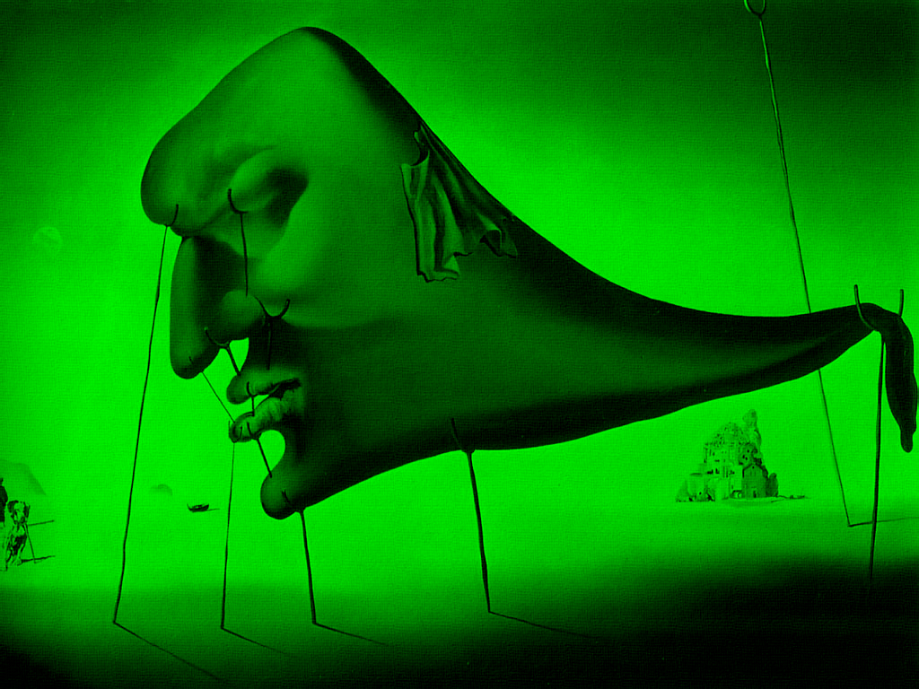
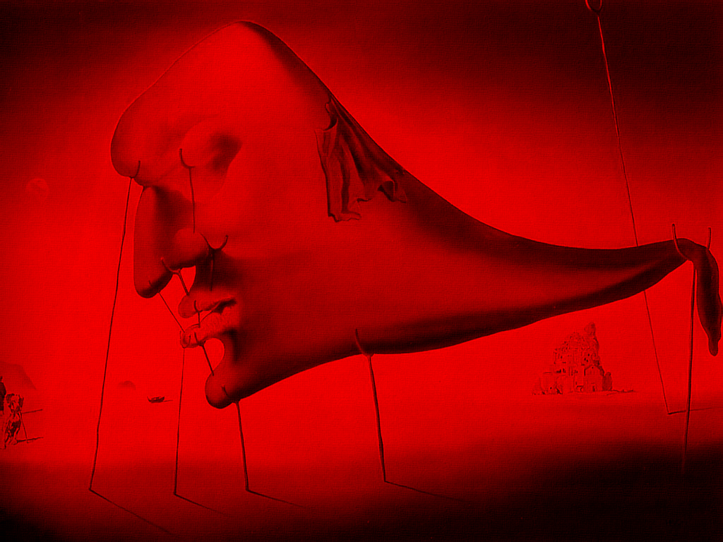
tensors
Multi-dimensional arrays of scalars
feature (C)
width (W)
Height (H)
B
G
R
Notes:
So what are tensors? Tensors are multi-dimensional arrays of data that flow through the network. These are the datatypes that the machine learning programs operate on. Each tensor type is described by its dimensionality, the number of elements in each dimension and the datatype of each element. One example of a tensor is an image with three “features” at each pixel location – red, green, blue color components. But tensors are much more general than that, they can describe higher-level content of the image, such as whether there’s a face present in a particular region, represent waveforms, or textual information.

Slide 9
Program-centric view
Of machine learning
Machine learning operators low-level machine instructions
Tensors basic datatypes
WinML graph optimizer code compiler
Want to define a tensor machine ISA
Notes:
So in this program-centric view of machine learning we can think of machine learning operators as machine instructions, tensors that flow through the network as basic datatypes that these instructions operate on and Windows ML graph optimizer being the compiler that takes a high-level description of the model and lowers it to the instruction set of a particular machine architecture. So in a sense what we want to define is a tensor processor ISA, which can be supported by implementations and targeted by the WinML graph optimizer. Individual instructions in this ISA are metacommands, a new feature of DX12 API.

Slide 10
D3d12 metacommands

Slide 11
metacommands
Tensor machine ISA
a
conv2d
tmp1
ReLU
tmp2
w
f
b
+
tmp3
FC
res
Notes:
So given the graph representation I’ve shown earlier we can easily identify individual operations which can be mapped to metacommands.

Slide 12
metacommands
Tensor machine ISA
Fully connected metacommand
a
conv2d
tmp1
ReLU
tmp2
w
f
b
+
tmp3
FC
res
Notes:
For example, the fully connected operation at the end can be mapped to a single hardware metacommand. Similar to a regular machine instruction, it has two inputs and produces one output.

Slide 13
metacommands
Tensor machine ISA
Element-wise metacommand
a
conv2d
tmp1
ReLU
tmp2
w
f
b
+
tmp3
FC
res
Notes:
Likewise, the elementwise operation in the network can be mapped to another metacomand.

Slide 14
Metacommands
Tensor machine ISA
Convolution + activation metacommand
a
conv2d
tmp1
ReLU
tmp2
w
f
b
+
tmp3
FC
res
Notes:
And convolution operation together with activation function following it can both be mapped to yet another metacommand. As I explained earlier, just like hardware instructions, metacommands don’t have to map 1:1 to high-level operations, and can represent “fused” operations. Here, convolution is “fused” with the activation function such that the implementation can optimize away storage for the temporary variable tmp1 between them. This is advantageous for performance in many cases and save bandwidth through the network.

Slide 15
metacommands
General definition
Input 0
Output 0
Meta
Command
…
…
Output M
Input N
Abstracts an optimized machine function
Notes:
So in general terms, a DX12 metacommand can be defined as a self-contained operation, with some prescribed functionality, defined in the spec. It is specified with a GUID, and can have multiple signatures. Analogously to draw and dispatch calls, metacommands can be inserted in command lists and scheduled for execution together other DX12 command types. A metacommand can have several inputs and several outputs. In the context of inferencing, inputs and outputs are tensor datatypes, which are stored in framebuffer memory, but the actual metacommand API doesn’t dictate any particular application for metacommands.

Slide 16
metacommands
General definition
Initialized at creation time
Input 0
Persistent meta-data
Output 0
Meta
Command
…
…
Output M
Input N
Scratch space
Read and written during meta command execution
Notes:
In addition to input and output parameters, metacommand can also request some scratch space it may need during operation, and some persistent storage which it can use to precompute some data needed for its operation. For example, a lookup table needed during execution can be stored there. Note that metacommands don’t create any resources themselves, all memory for inputs, outputs, scratch and persistent metadata are supposed to be allocated by the client and supplied to metacommands during execution.

Slide 17
Life of a metacommand
Metacommand overview
Enumerate metacommands and their signatures
Query implementation for supported metacommands
Create metacommand
Create metacommand object instance
Get required resource sizes
Query memory footprint requirements for parameters and scratch space
Notes:
From the client perspective, there is a number of steps involved in using metacommands.
First, the client needs to enumerate supported metacommands – implementations are not required to support all of them. In fact, initially only a few key metacommands will be exposed. Also, only a subset of metacommand signatures may be supported.

Slide 18
Life of a metacommand
Metacommand overview
Initialize metacommand
Initialize persistent scratch resources of the metacommand
Insert into the command list
Schedule metacommand instance for execution on the command list
Notes:
As I mentioned earlier, implementations can run some precomputation during Initialize() call which will fill out its persistent metadata as a result. This persistent metadata will need to be provided to the metacommand every time it is invoked.
Finally, the metacommand object can be inserted in the command list for execution, just like you would insert a draw() or a dispatch() call. Both graphics and compute command lists are supported.

Slide 19
Metacommand parameters
Specified in memory structures
Per input, output tensor | Type
Location | GPU_VIRTUAL_ADDRESS
Element type | FP32 or FP16
Dimensions | {batch, width, height, depth}
Memory layout | NCHW or hardware native
Per metacommand instance | Type
Scratch | GPU_VIRTUAL_ADDRESS
Persistent meta-data | GPU_VIRTUAL_ADDRESS
Metacommand options | <varies>
Notes:
Explain how metacommands parameters are specified
Talk about the importance of memory layouts
Linear buffers today, more complex inputs (like images) in the future.

Slide 20
Metacommand examples
Notes:
Next I’ll describe a few common metacommands, actually just two of them. They are also the most common and the most computationally expensive operations in inferencing, so it makes sense to have them exposed as metacommands. We’ll see how they can be implemented efficiency, leveraging optimized algorithms, which tailor specific hardware architectures.

Slide 21
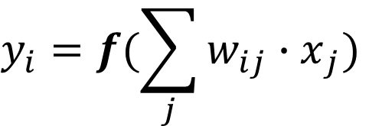



Fully connected operator
Each element in the output depends on all elements in the input
$$x_{j}$$
$$w_{ij}$$
$$y_{i}$$
0
0
$$y_{i}=f(\sum_{j}{{w_{ij}∙x}_{j})}$$
1
1
2
2
Notes:
The first metacommand I’m going to describe is called a fully connected operation. Each connection is labeled with a weight, the operator evaluates a weighted sum of values (activations) at the input. Only 3 inputs/outputs for clarity, normally differently sized input and output Output is normally a 1D tensor. During learning process, what is being learned is weights of the connections. Normally followed by an activation function

Slide 22
Fully connected operator
Each element in the output depends on all elements in the input
$$x_{j}$$
$$w_{ij}$$
$$y_{i}$$
0
0
$$y_{i}=f(\sum_{j}{{w_{ij}∙x}_{j})}$$
1
1
2
2

Slide 23
Fully connected operator
Each element in the output depends on all elements in the input
$$x_{j}$$
$$w_{ij}$$
$$y_{i}$$
0
0
$$y_{i}=f(\sum_{j}{{w_{ij}∙x}_{j})}$$
1
1
2
2

Slide 24
Fully connected operator
Each element in the output depends on all elements in the input
$$x_{j}$$
$$w_{ij}$$
$$y_{i}$$
0
0
$$y_{i}=f(\sum_{j}{{w_{ij}∙x}_{j})}$$
1
1
2
2

Slide 25
fully connected operation as a matrix multiplication
Notes:
Now let’s see how this operation can be expressed efficiently as a matrix multiplication. The reason it is important is that the matrix multiplication is a very well understood problem, which can be optimized in many different ways. By taking advantage of the regular structure of the matrix multiplication operation, drivers can provide highly tuned implementations of such operations, leveraging architecture-specific knowledge such as cache sizes, details of scheduling, etc.

Slide 26







Fully connected operator
As matrix multiplication
$$n=12$$
$$m=16$$
$$W$$
*
=
$$m=16$$
$$n=12$$
$$X$$
$$Y$$
Notes:
We write out the input tensor as column vector of elements, then we write out the weight matrix as a 2D array of weights, and multiplying them together generates the output vector

Slide 27
Convolutions on tensors
Convolving input tensor with 3 filter kernels
Input tensor X [4, 8, 8]
3 filter kernels W [4, 2, 2]
Notes:
Another very important operation in CNN is convolution, of course.
Heres a standard convolution problem, where you have a tensor at the input and a number of filter kernels to apply to it.
Using the standard NCHW notation here where channel dimension comes first
The number of channels in the filter and in the input tensor must match
Kernels is what is typically being learned during training

Slide 28
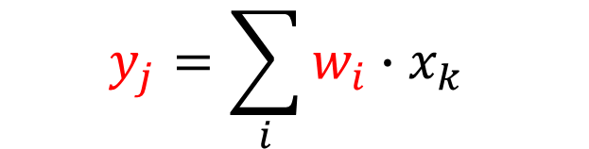
Convolutions on tensors
Applying red filter kernel across entire tensor with a stride of 3
$$y_{j}=\sum_{i}{w_{i}∙x_{k}}$$
Notes:
So we take each kernel in turn and apply it across the entire tensor. Here I’m using a stride of 3 for illustration purposes, but of course other configurations possible, including those where filter kernels overlap. At each step we evaluate a weighted sum between the elements of the filter kernel and elements in the input tensor under the correspodnign filter kernel footprint.

Slide 29
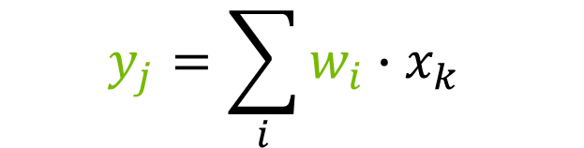
Convolutions on tensors
… Repeat for green
$$y_{j}=\sum_{i}{w_{i}∙x_{k}}$$

Slide 30
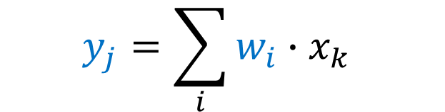
Convolutions on tensors
… Repeat for blue
$$y_{j}=\sum_{i}{w_{i}∙x_{k}}$$

Slide 31
Convolutions on tensors
Stack them together to form the resulting tensor

Slide 32
Convolutions on tensors
Convolving input tensor with 3 filter kernels
=
*
Input tensor [4, 8, 8]
3 filter kernels [4, 2, 2]
Output tensor [3, 3, 3]
Notes:
So the result of evaluating a convolution operation given the input tensor X of dimensions 4,8,8 and 3 filter kernels of sizes 4, 2, 2 we have an output tensor of shape 3,3,3
Again, we have the same number of channels in filters and in the input
The output has the same number of channels as the number of filter kernels in the filterbank

Slide 33
Lowering convolutions to matrix multiplication
Notes:
Lets see how we can implement these convolutions as matrix multiplication.

Slide 34



Convolution as matrix multiplication
Forming the filter matrix
$$k=16$$
$$F=$$
$$m=3$$
Notes:
First, we need to have a way to express input data as matrices. Here’s how we do it for the filter kernels.

Slide 35

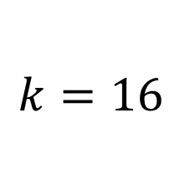

Convolution as matrix multiplication
Forming the input tensor matrix
$$n=9$$
$$k=16$$
$$X=$$
Input tensor X [4, 8, 8]
Notes:
We can do the same for the input tensor, writing out its elements under the filter footprint as matrix columns. You may think that this is a very inefficient way of expressing the input tensor data since in the case where filter kernels overlap, we’ll have to store the data redundantly. However, this matrix doesn’t have to exist in memory explicitly. IN fact, implementations can materialize this matrix on the fly, gathering appropriate elements from the input tensor and loading them into the register file of the processor as needed.

Slide 36







Convolution as matrix multiplication
Evaluating the matrix product
$$n=9$$
Output tensor [3, 3, 3]
$$k=16$$
$$X$$
$$k=16$$
$$m=3$$
$$F$$
$$F∙X$$
Notes:
So we take the X matrix and multiply it from the left by the F matrix. The result will have a shape of mxn (3x9 in this case), which will contain results of convolving the input tensor by the filter kernels contained in the F matrix as rows in the matrix. These rows can then be reshaped into the output tensor.

Slide 37
Efficient matrix multiplication
Notes:
(20-25 min mark)
So as we saw, both fully connected and convolution operators can be expressed as matrix multiplication. So the problem boils down to implementing these matrix multiplications efficiently – let’s see how that can be accomplished.

Slide 38
matrix multiplication
Notes:
Matrices we operate on are typically large 2-dimensional arrays of numbers, stored in global memory either in row-major or column-major layout. They can also be materialized dynamically, as I explained earlier.

Slide 39
matrix multiplication
A naïve method
Notes:
A naïve high-school matrix multiplication evaluates elements in the result one by one, computing full dot products between corresponding rows and columns in the input matrices. Although this is easy to understand, this approach is very inefficient since it reads entire rows and columns of the input matrices for each output element, which is very likely to thrash on-chip caches. As a result, the same elements of the matrices are being read repeatedly over and over again, resulting in poor performance

Slide 40
matrix multiplication
A naïve method
Notes:
A naïve high-school matrix multiplication evaluates elements in the result one by one, computing full dot products between corresponding rows and columns in the input matrices. Although this is easy to understand, this approach is very inefficient since it reads entire rows and columns of the input matrices for each output element, which is very likely to thrash on-chip caches. As a result, the same elements of the matrices are being read repeatedly over and over again, resulting in poor performance

Slide 41
matrix multiplication
A naïve method
Notes:
A naïve high-school matrix multiplication evaluates elements in the result one by one, computing full dot products between corresponding rows and columns in the input matrices. Although this is easy to understand, this approach is very inefficient since it reads entire rows and columns of the input matrices for each output element, which is very likely to thrash on-chip caches. As a result, the same elements of the matrices are being read repeatedly over and over again, resulting in poor performance

Slide 42
matrix multiplication
A naïve method
Notes:
A naïve high-school matrix multiplication evaluates elements in the result one by one, computing full dot products between corresponding rows and columns in the input matrices. Although this is easy to understand, this approach is very inefficient since it reads entire rows and columns of the input matrices for each output element, which is very likely to thrash on-chip caches. As a result, the same elements of the matrices are being read repeatedly over and over again, resulting in poor performance

Slide 43
matrix multiplication
A naïve method
Notes:
A naïve high-school matrix multiplication evaluates elements in the result one by one, computing full dot products between corresponding rows and columns in the input matrices. Although this is easy to understand, this approach is very inefficient since it reads entire rows and columns of the input matrices for each output element, which is very likely to thrash on-chip caches. As a result, the same elements of the matrices are being read repeatedly over and over again, resulting in poor performance

Slide 44
matrix multiplication
A naïve method
Notes:
A naïve high-school matrix multiplication evaluates elements in the result one by one, computing full dot products between corresponding rows and columns in the input matrices. Although this is easy to understand, this approach is very inefficient since it reads entire rows and columns of the input matrices for each output element, which is very likely to thrash on-chip caches. As a result, the same elements of the matrices are being read repeatedly over and over again, resulting in poor performance

Slide 45




Tiled matrix multiplication
Memory efficient
$$B$$
$$D=A∙B$$
$$A$$
$$D$$
Notes:
A much better approach is to tile the matrix multiply. Tiles in the destination matrix A * B are computed by repeatedly accumulating results of multiplying sub-matrices from A and B (darker shades). This has the benefit of maximizing data reuse and limiting the working set so that data accesses can be contained in on-chip memories close to the processor, thus improving computational density of the algorithm.
Again, the details of the optimal tile size will be highly architecture dependent, and there’s no “one size fits all” solution.

Slide 46



Tiled matrix multiplication
Memory efficient
$$B$$
$$D+=A∙B$$
$$A$$
$$D$$
Notes:
A much better approach is to tile the matrix multiply. Tiles in the destination matrix A * B are computed by repeatedly accumulating results of multiplying sub-matrices from A and B (darker shades). This has the benefit of maximizing data reuse and limiting the working set so that data accesses can be contained in on-chip memories close to the processor, thus improving computational density of the algorithm.
Again, the details of the optimal tile size will be highly architecture dependent, and there’s no “one size fits all” solution.

Slide 47


Tiled matrix multiplication
Memory efficient
$$D+=A∙B$$
$$B$$
$$A$$
$$D$$
Notes:
A much better approach is to tile the matrix multiply. Tiles in the destination matrix A * B are computed by repeatedly accumulating results of multiplying sub-matrices from A and B (darker shades). This has the benefit of maximizing data reuse and limiting the working set so that data accesses can be contained in on-chip memories close to the processor, thus improving computational density of the algorithm.
Again, the details of the optimal tile size will be highly architecture dependent, and there’s no “one size fits all” solution.

Slide 48


Tiled matrix multiplication
Memory efficient
$$D+=A∙B$$
$$B$$
$$A$$
$$D$$
Notes:
A much better approach is to tile the matrix multiply. Tiles in the destination matrix A * B are computed by repeatedly accumulating results of multiplying sub-matrices from A and B (darker shades). This has the benefit of maximizing data reuse and limiting the working set so that data accesses can be contained in on-chip memories close to the processor, thus improving computational density of the algorithm.
Again, the details of the optimal tile size will be highly architecture dependent, and there’s no “one size fits all” solution.

Slide 49
Tiled matrix multiplication
Memory efficient, hierarchical
$$D+=A∙B$$
$$B$$
$$A$$
$$D$$
Notes:
In fact, the same decomposition can also be applied to the individual tiles in the matrix, resulting in a hierarchical approach, where matrices are recursively subdivided and processed, matching details of a memory hierarchy of a given processor. Again, the details of that subdivision is highly architecture specific.
So at a fundamental level, any big matrix multiplication operation can be decomposed into a series of smaller, fixed-sized matrix multiplications. These fixed-sized matrix multiplications can be directly accelerated by hardware, which is where tensor cores come in.

Slide 50
Volta tensor cores

Slide 51
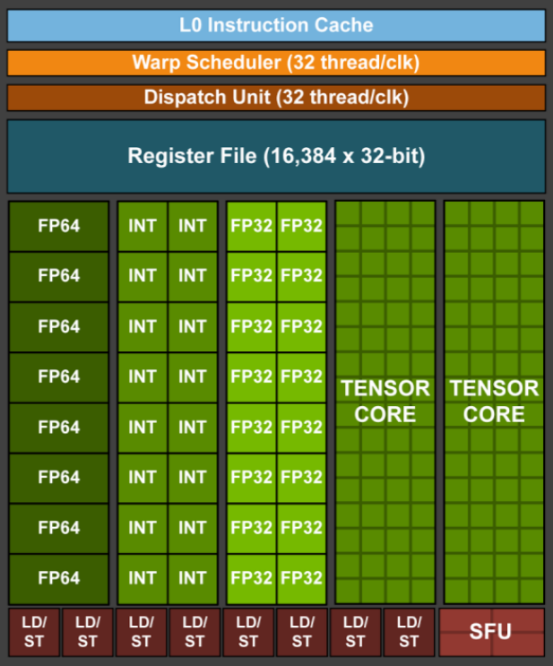
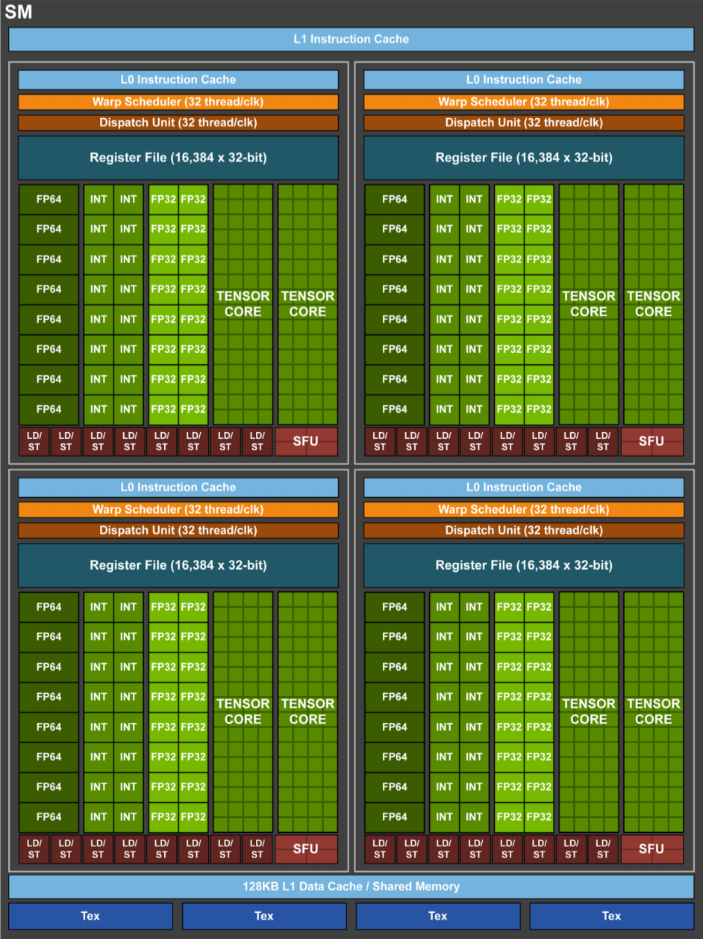
Volta sm tensor cores
Dedicated hardware datapaths for machine learning acceleration
8 Tensor cores per SM
512 FMA operations per clock
Mixed precision operation
110 TFLOPs peak on TitanV
Notes:
In our most recent GPU architecture called Volta, we introduced an entirely new SM design, which, along with many other improvements, included a set of dedicated hardware datapaths called tensor cores which are optimized specifically for machine learning acceleration.
Each Volta SM has 8 tensor cores, collectively delivering up to 512 FMA operations per clock. Compare that to 64 FMA operations per clock per SM for regular FP32 math. So tensor cores can deliver up to 8x computation density, or 110 TFLOPs in peak on a TitanV GPU.

Slide 52
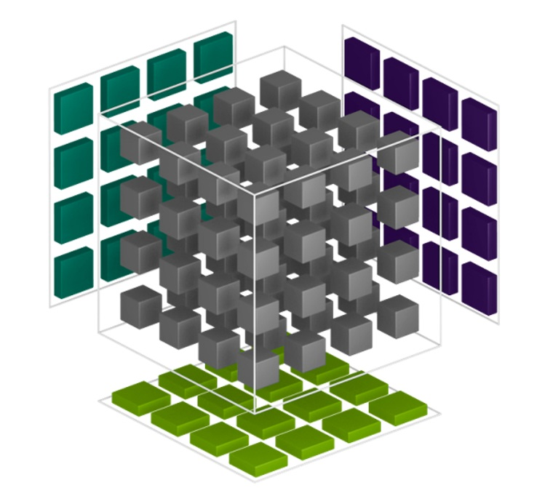





Tensor core operation
A fixed-size matrix multiply-add
$$B$$
FP16
*
$$D$$
=
$$A$$
$$A∙B$$
+
$$C$$
FP16 or FP32
FP16
FP16 or FP32
Notes:
Tensor cores are hardwired to perform a fixed-sized matrix multiply add operations. Given input matrices A and B, the tensor cores compute their product, adding it to the third operand C. The operation is done in “mixed precision”, where accumulation can be done in fp32, while operands are fp16

Slide 53
Tensor core operation
Warp-wide Matrix Math
warp
Warp-synchronizing operation
=
+
Composed Matrix Multiply and Accumulate
Result distributed across warp
Notes:
Tensor cores employ all threads in the warp to provide data for input matrices. This is necessary to provide sufficient operand bandwidth to the math hardware downstream. The specifics of how the matrices are split across participating threads is implementation-dependent, which is why this operation is hard to expose as DirectCompute primitive. Fully utilizing the datapaths also requires careful instruction scheduling, which is only possible in a carefully tuned code.

Slide 54
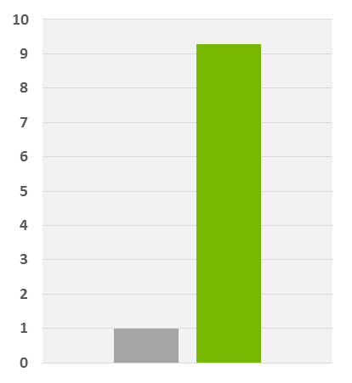
Tensor core performance
Almost an order of magnitude performance increase
cuBLAS Mixed Precision (FP16 input, FP32 compute)
Matrix Multiply (M=N=K=2048)
Relative Performance
9.3x
faster
P100
V100 – Tensor Cores
Notes:
Tensor core usage in optimized implementations provides substantial performance boost. In basic linear algebra operations it can be almost an order of magnitude faster relative to previous generation architectures.

Slide 55
Style transfer demo
Notes:
To illustrate the kind of performance gains which can be obtained with metacommands optimized for tensor cores, we have a demo I’d like to show.
Training took between 2-4 hours each on a GP100x4 system (trained on image crops)

Slide 56
Style transfer
Some facts about the demo
16 convolution layers with residual connections
Almost 640 billion floating-point operations per evaluation
80% of peak tensor core performance delivered in most convolution layers
Up to 88 TFLOPs compute density
Notes:
First major publication: "A Neural Algorithm for Atristic Style", Gatys et al:
https://arxiv.org/abs/1508.06576 ,
In their paper, Gatys et. al show that if we take a convolutional neural network that has
already been trained to recognise objects within images then that network will have
developed some internal representations of the content and style contained within a given
image. What’s more, these representations will be independent from each other, so we can
use the content representation from one image and style representation from another to
generate a brand new image

Slide 57
Style transfer performance
NVIDIA TitanV @ 1080p, absolute perf
Frames per second
3.1x
2.5x
Notes:
Compare fp32, fp16 and non-metacommands paths
Per eval:
Baseline: 294 ms
FP32 metacommands (TitanV): 116 ms
FP16 metacommands (TitanV tensor cores): 34 ms

Slide 58
Style transfer performance
NVIDIA TitanV @ 1080p, relative speedup
Relative speedup
8x
2.5x
1x
Notes:
Compare fp32, fp16 and non-metacommands paths
Per eval:
Baseline: 294 ms
FP32 metacommands (TitanV): 116 ms
FP16 metacommands (TitanV tensor cores): 34 ms

Slide 59
Summary
DirectML implements core machine learning operations in DirectCompute
Metacommands allow implementations export optimized versions of those operations
NVIDIA’s HW and SW provides accelerated support for machine learning
Machine learning is here and can be used in games today
Windows ML is available now in Windows 10

Slide 60


GDC ATTENDEES SAVE 20%
REGISTER AT: www.gputechconf.com
USE CODE: GMGDC
Featuring new gaming track focused on deep learning and AI on Monday, 26 March 2018

Slide 61
Stuart Schaefer, Microsoft
Yury Uralsky, NVIDIA
Daniel Kennett, Microsoft

Slide 62
Convolutions on tensors
Notes:
TODO: need a better picture/explanation

Slide 63
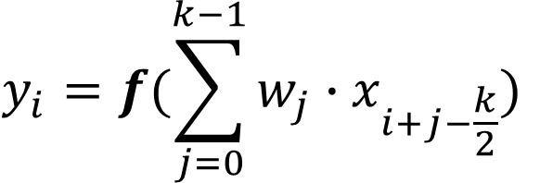
Convoluton operator
Each element in the output depends on the local neighborhood in the input
x
0
y
0
0
1
1
$$y_{i}=f(\sum_{j=0}^{k−1}{{w_{j}∙x}_{i+j−\frac{k}{2}})}$$
2
2
3
3
4
4
0
Notes:
Normally same sized inputs and outputs (can be strided)
Various boundary conditions

Slide 64
Convoluton operator
Each element in the output depends on the local neighborhood in the input
x
0
y
0
0
1
1
$$y_{i}=f(\sum_{j=0}^{k−1}{{w_{j}∙x}_{i+j−\frac{k}{2}})}$$
2
2
3
3
4
4
0
Notes:
Normally same sized inputs and outputs (can be strided)
Various boundary conditions

Slide 65
Convoluton operator
Each element in the output depends on the local neighborhood in the input
x
0
y
0
0
1
1
$$y_{i}=f(\sum_{j=0}^{k−1}{{w_{j}∙x}_{i+j−\frac{k}{2}})}$$
2
2
3
3
4
4
0
Notes:
Normally same sized inputs and outputs (can be strided)
Various boundary conditions

Slide 66
Convoluton operator
Each element in the output depends on the local neighborhood in the input
x
0
y
0
0
1
1
$$y_{i}=f(\sum_{j=0}^{k−1}{{w_{j}∙x}_{i+j−\frac{k}{2}})}$$
2
2
3
3
4
4
0
Notes:
Normally same sized inputs and outputs (can be strided)
Various boundary conditions

Slide 67
Convoluton operator
Each element in the output depends on the local neighborhood in the input
x
0
y
0
0
1
1
$$y_{i}=f(\sum_{j=0}^{k−1}{{w_{j}∙x}_{i+j−\frac{k}{2}})}$$
2
2
3
3
4
4
0
Notes:
Normally same sized inputs and outputs (can be strided)
Various boundary conditions

Slide 68
Convoluton operator
Each element in the output depends on the local neighborhood in the input
x
0
y
0
0
1
1
$$y_{i}=f(\sum_{j=0}^{k−1}{{w_{j}∙x}_{i+j−\frac{k}{2}})}$$
2
2
3
3
4
4
0
Notes:
Normally same sized inputs and outputs (can be strided)
Various boundary conditions

Slide 69
Convolution as matrix multiplication
Notes:
TODO: need a better picture/explanation

Slide 70
metacommands
Tensor machine ISA
Activation metacommand
a
conv2d
tmp1
ReLU
tmp2
w
f
b
+
tmp3
FC
res

