Slide 1
Deep Learning for Game Developers
Bryan Catanzaro, VP Applied Deep Learning Research
March 22, 2018

Slide 2
Deep Learning
Huge progress in many fields
communication
沟通

Slide 3
Why deep learning
Scale Matters
Millions to Billions of parameters
Data Matters
Learn with more data
Productivity Matters
SW + HW tools speed experiments
Accuracy
Deep Learning
Many previous
methods
Data & Compute

Slide 4
Deep neural net
Function approximator
One layer
nonlinearity
Deep Neural Net
Stacked layers learn progressively more useful features
Can be practically trained on huge datasets

Slide 5
Supervised Learning
Learning mappings from labeled data
YES
NO
Learning X ➡ Y mappings is hugely useful

Slide 6
Supervised learning
Learning mappings from labeled data
Image classification
Speech recognition
Speech synthesis
Recommendation systems
Natural language understanding
(Game state, action) ➡ reward
Most surprisingly: these mappings can generalize

Slide 7
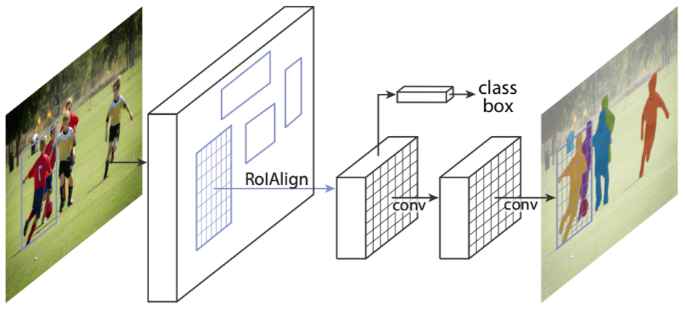
Mask R-CNN
He et al., FAIR, https://arxiv.org/abs/1703.06870
Instance segmentation
Predicts a proposal box,
a class label,
and a mask for each proposal
Deals well with occluding objects
Building block for pose estimation

Slide 8
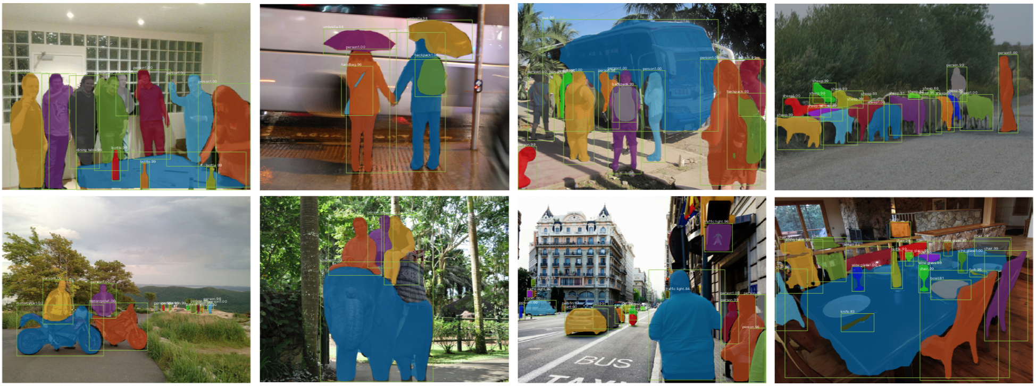
Mask R-CNN Results
He et al., FAIR, https://arxiv.org/abs/1703.06870

Slide 9
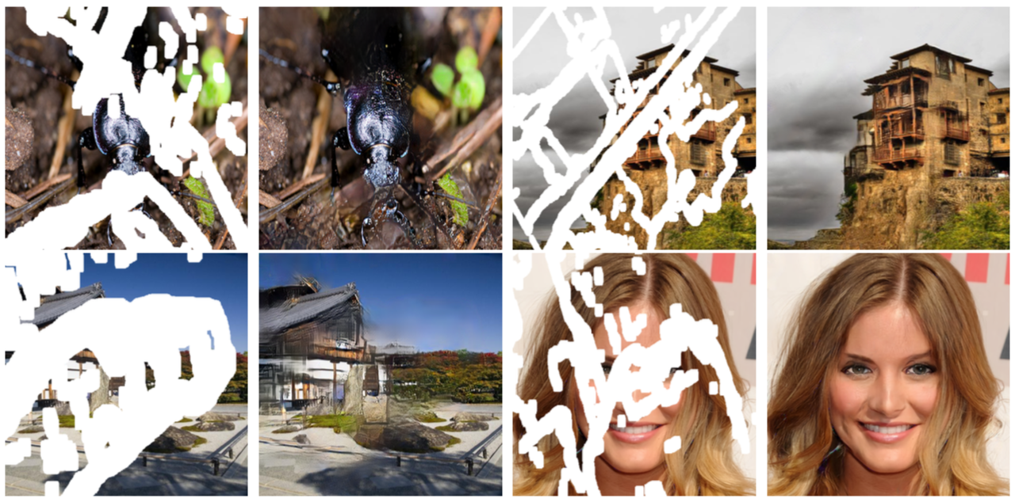
Image inpainting
Guilin Liu, NVIDIA

Slide 10
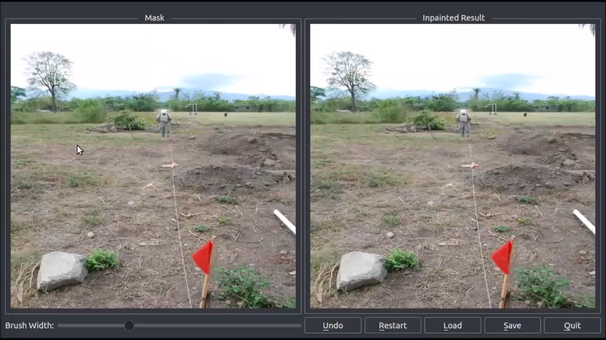

Slide 11
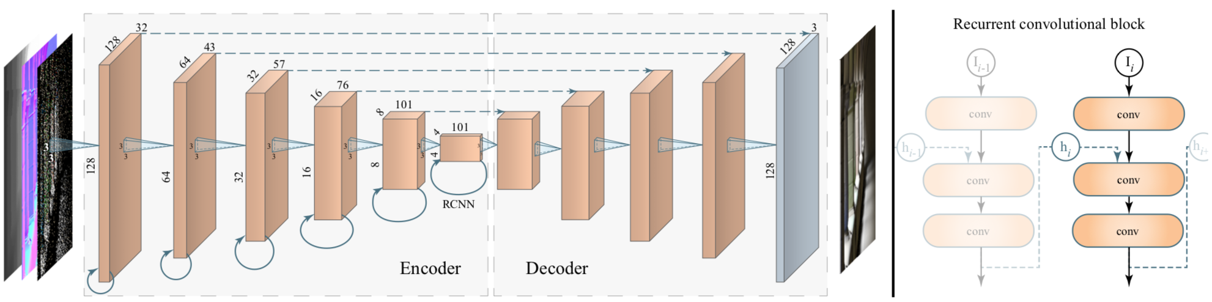
Raytracing Denoising
Chaitanya et al., NVIDIA, SIGGRAPH 2017
Recurrence adds temporal stability
Consumes auxiliary information (depth, roughness), not just noisy RGB

Slide 12
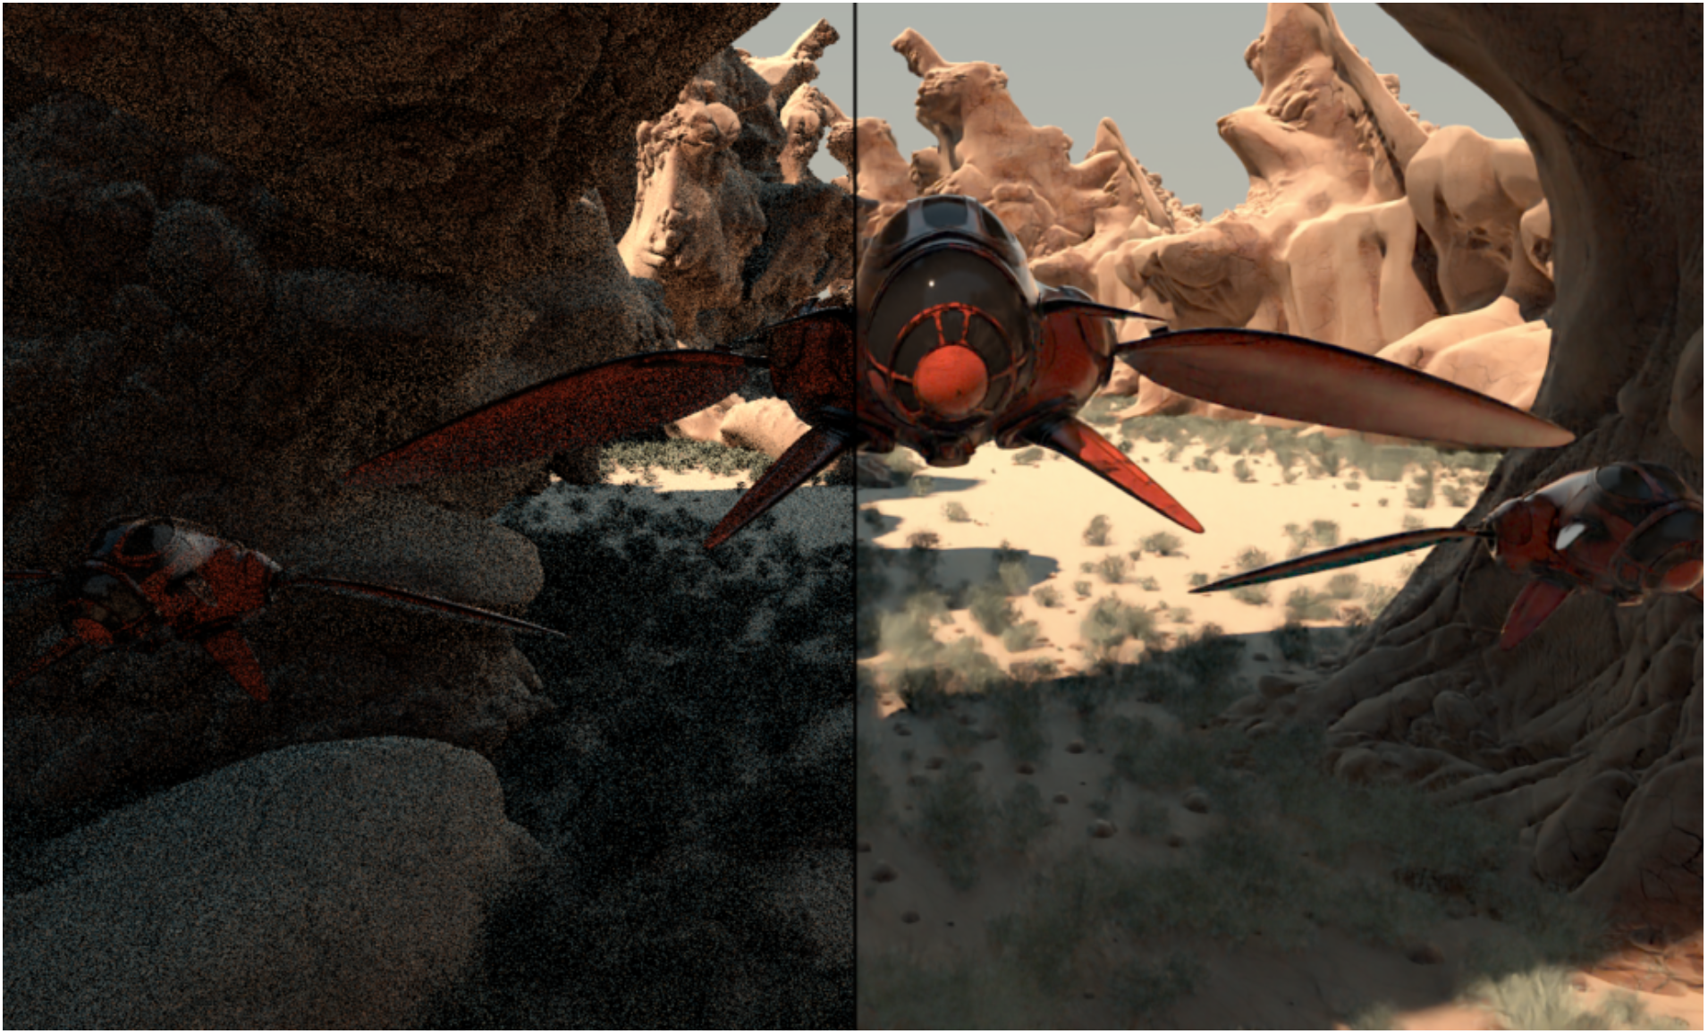

Slide 13
Blind image quality metrics for raytracing convergence estimation
Andrew Tao, NVIDIA
Unconverged
Converged

Slide 14

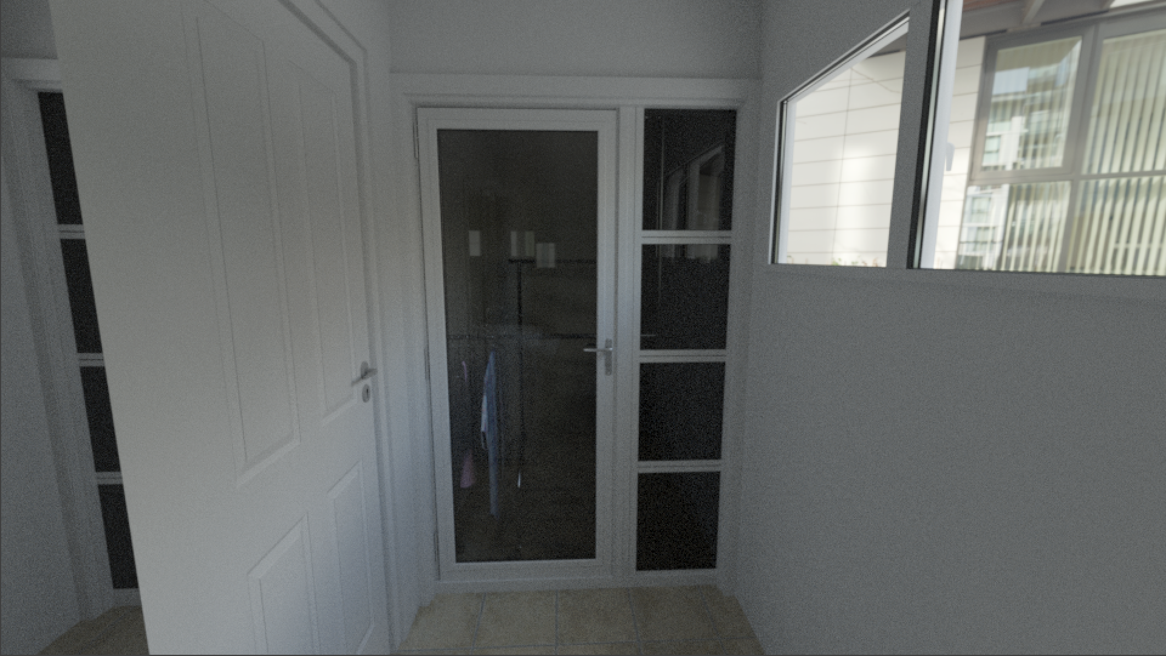
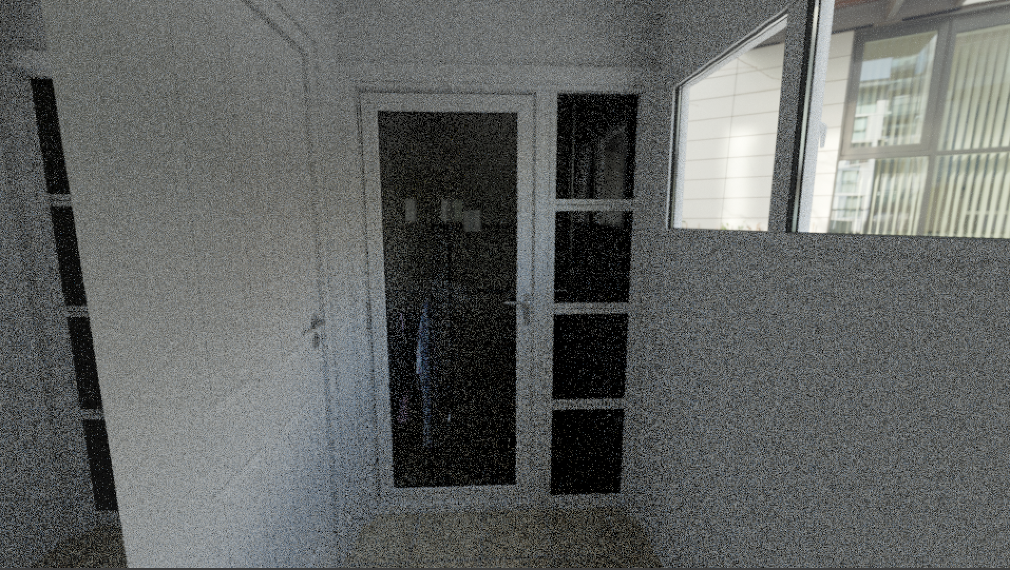
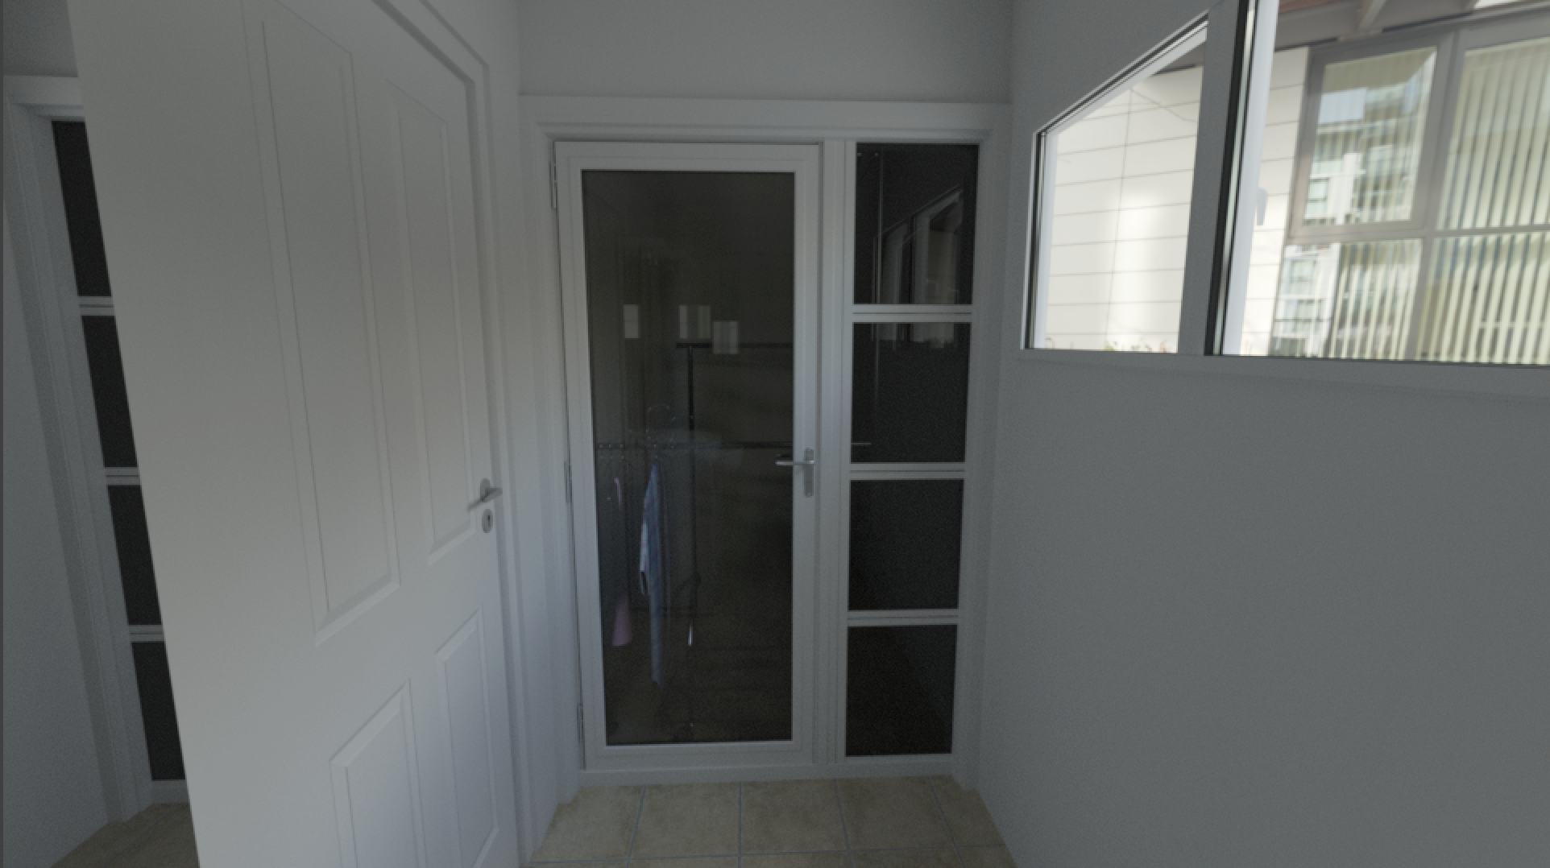
SSIM prediction
8 iters.
0.13 SSIM
4096 iters.
0.91 SSIM
128 iters.
0.33 SSIM
128k iters.
1.0 SSIM

Slide 15
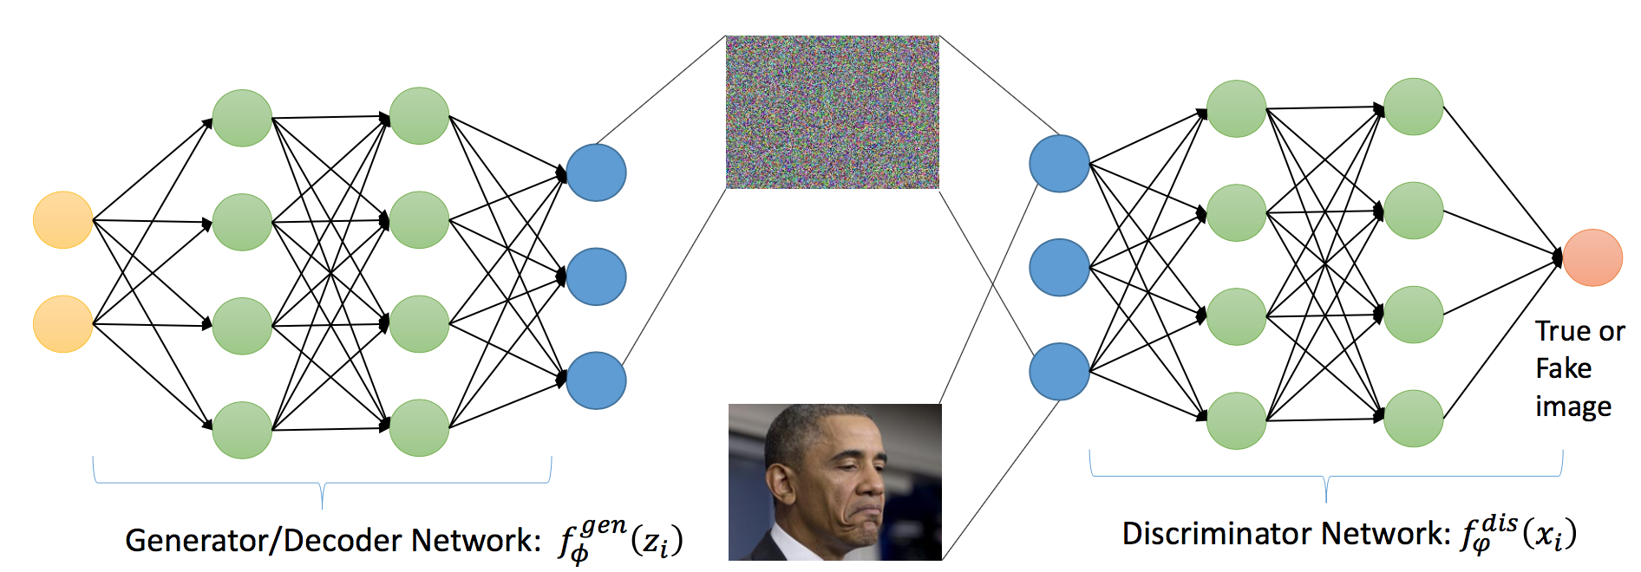
Generative adversarial networks
Ming-Yu Liu
Exciting technique for unsupervised learning
Discriminator teaches generator how to create convincing output

Slide 16
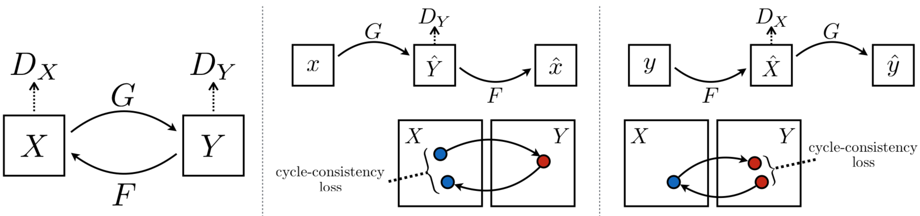
CycleGAN
Yan et al., Berkeley, https://github.com/junyanz/CycleGAN
Image translation without image pairs
Cycle consistency loss

Slide 17
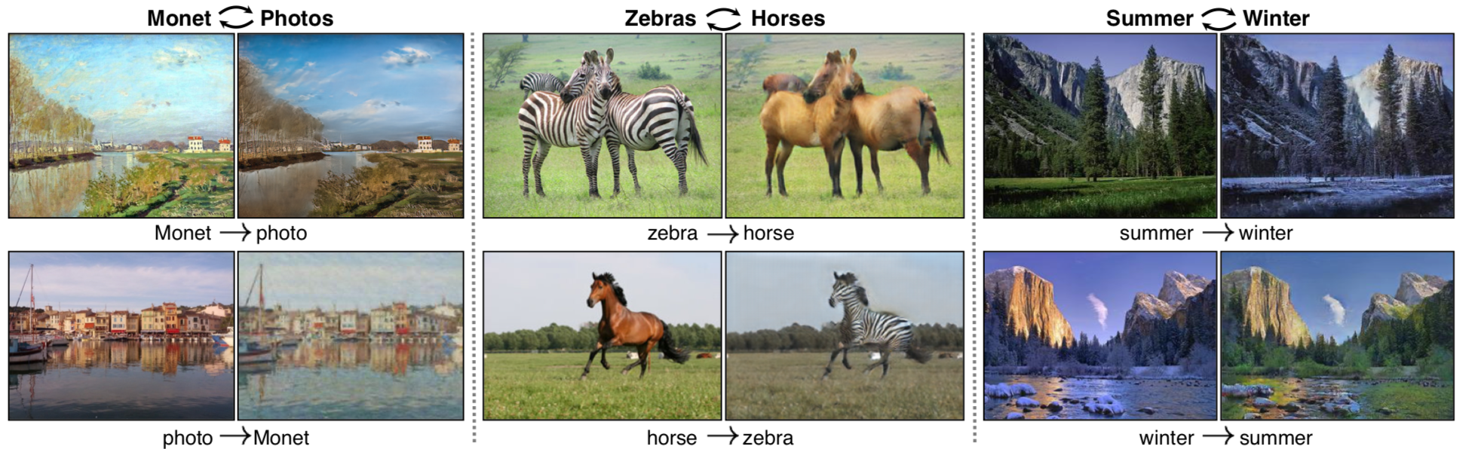
CycleGAN
Yan et al., Berkeley, https://github.com/junyanz/CycleGAN

Slide 18
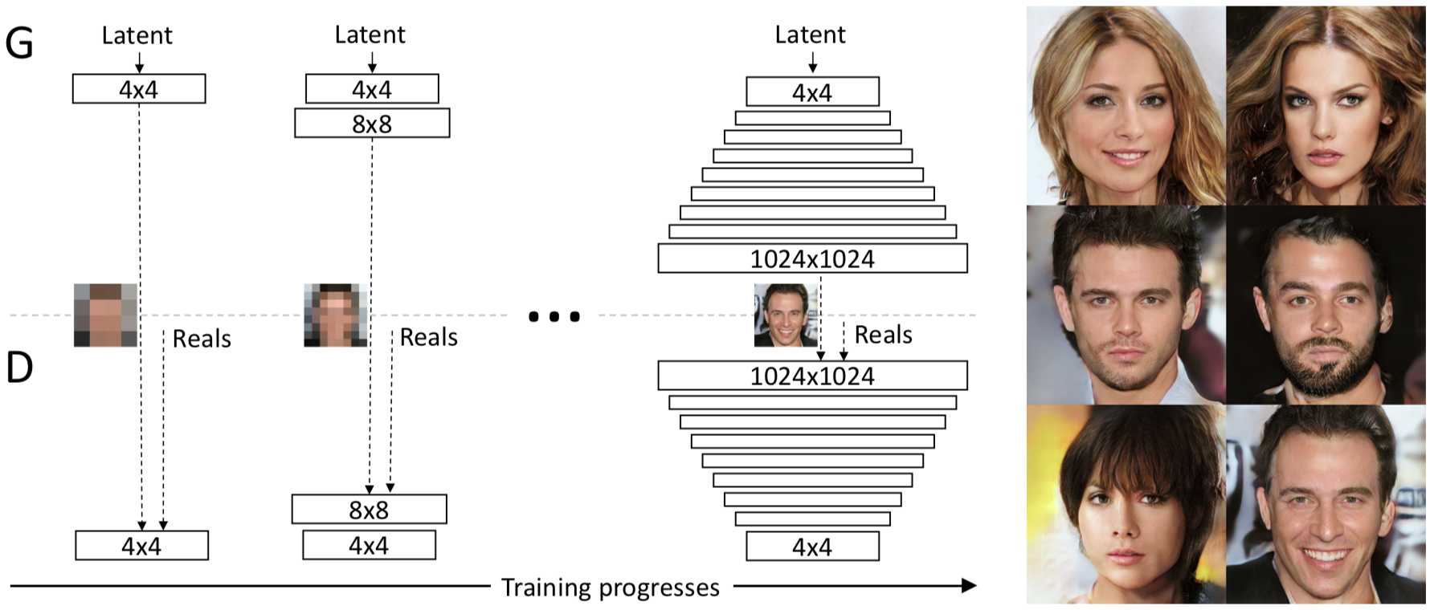
Progressive GAN
Karras et al, https://github.com/tkarras/progressive_growing_of_gans

Slide 19
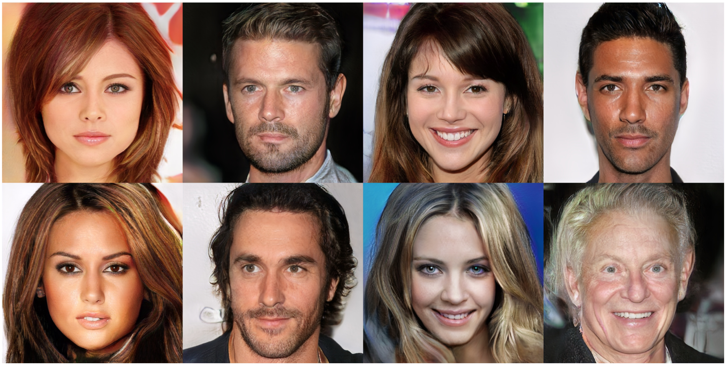
Progressive GAN
1 Megapixel images

Slide 20
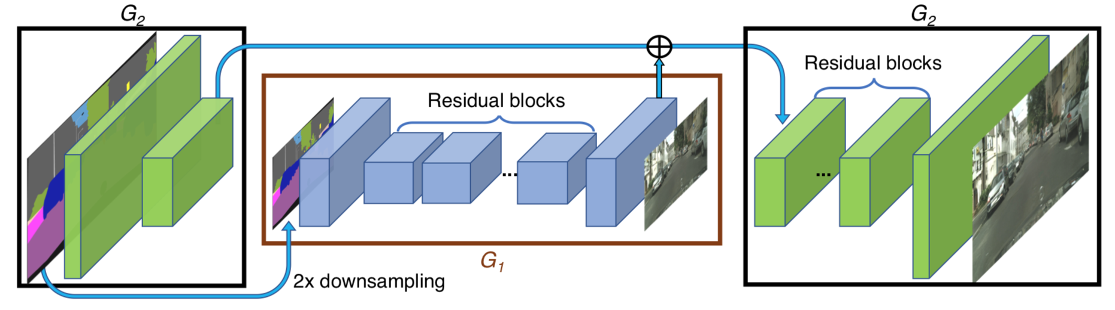
Rendering from Semantic Labels using GANs
Wang et al., NVIDIA, https://github.com/NVIDIA/pix2pixHD
High resolution output (2Mpixel)

Slide 21
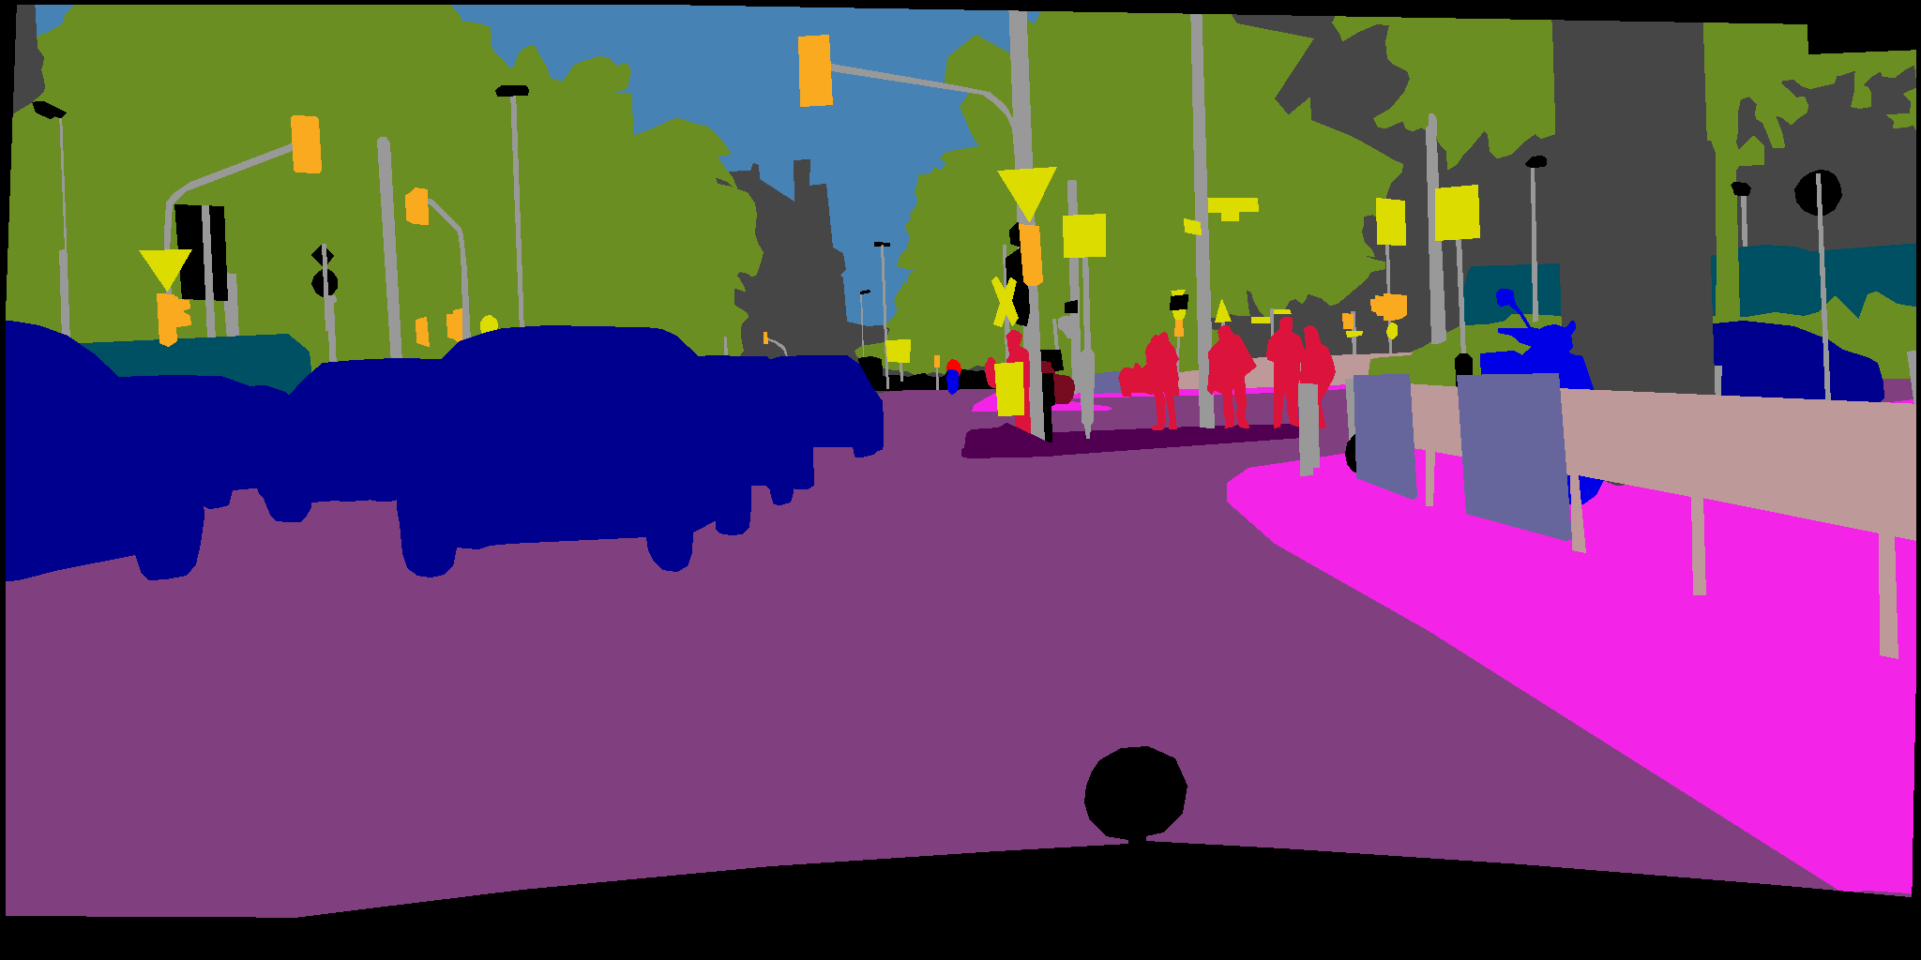
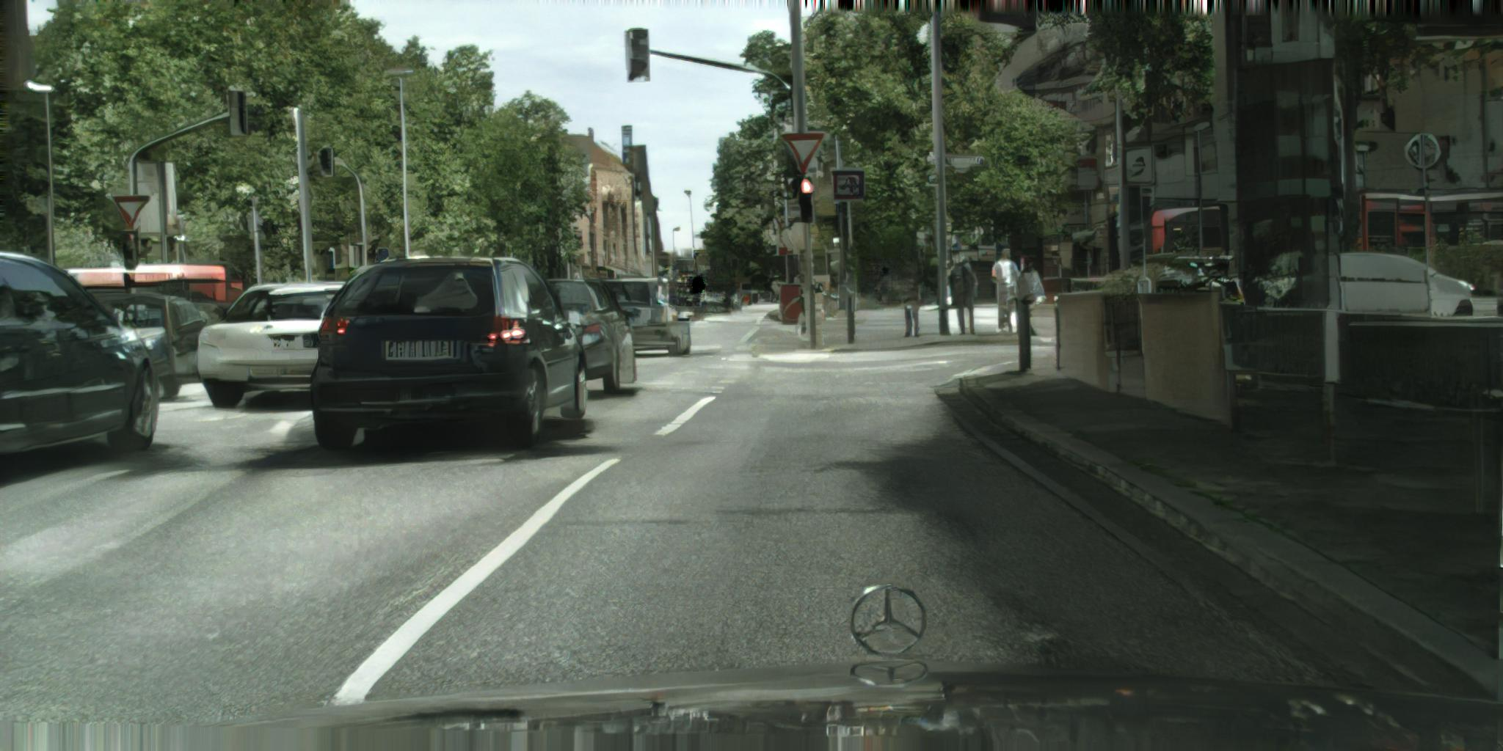

Slide 22
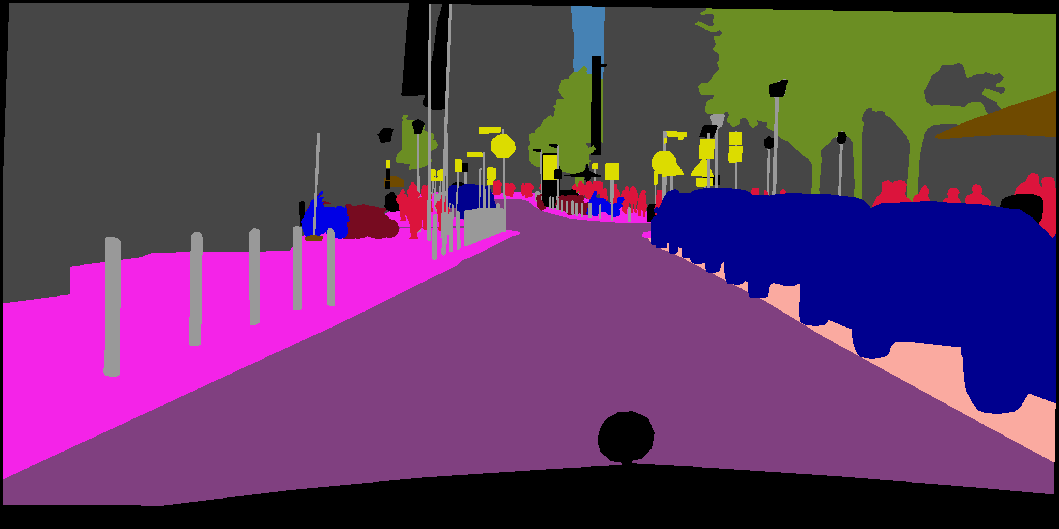
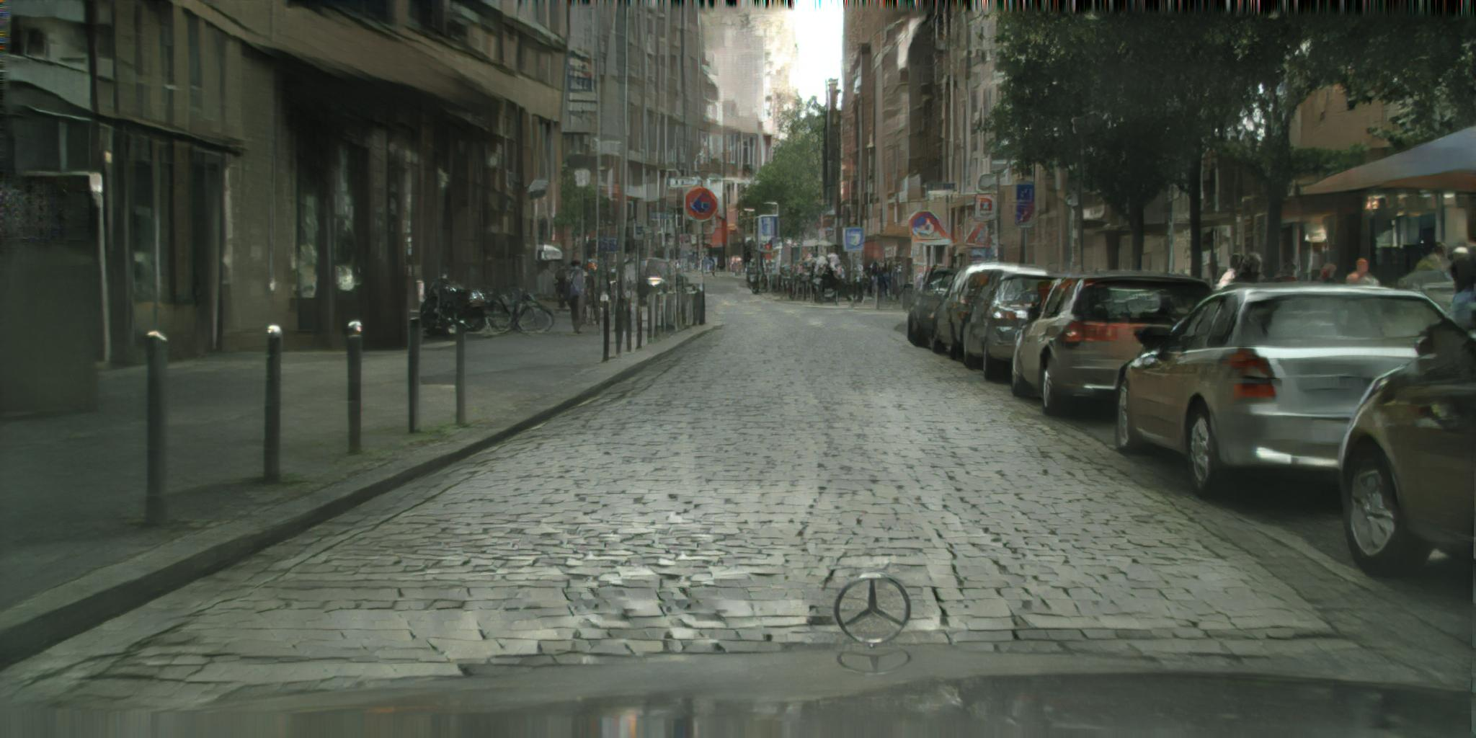

Slide 23
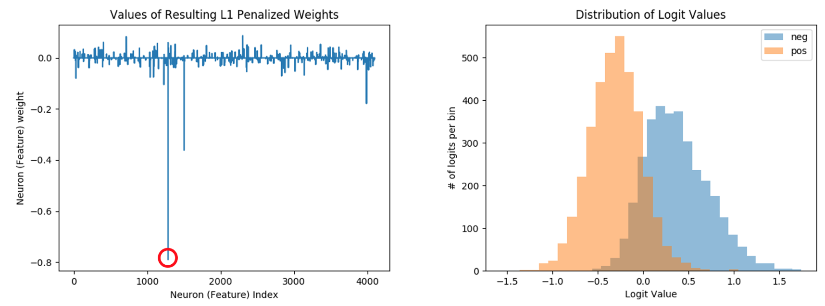
Unsupervised learning for text
Radford et al., OpenAI, “Learning to Generate Reviews and Discovering Sentiment”
Applying to various problems at NVIDIA in marketing and forecasting

Slide 24
Results
https://github.com/NVIDIA/sentiment-discovery
Join our Discord server to discuss games, share memes, or even play together with fellow members. Now playing PUBG!
omg e3 is so dope, new assassins creed looks lit, and pubg also looks insane for console
Well I'm just about done with fidding around with PUBG. Wake me up when it comes out of early access I guess or when console comes out.
Cool. Another gun game. Im excited.
Chicken Chasers #1 in our 427 part series of getting a chicken dinner in PUBG is up and it's great. #RIPMoira.

Slide 25


Parallel Wavenet for TTS
Oord et al, DeepMind/Google, https://arxiv.org/abs/1711.10433
SOTA Non-wavenet
Wavenet

Slide 26
Conclusion
Progress in many fields
Generative models coming into their own
Core computer vision still improving
Unsupervised learning starting to be useful
Questions:
@ctnzr

